Slide 1
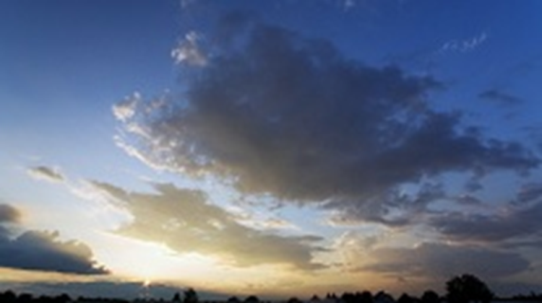

YOU ARE INVITED
Moonlight in the Meadows
Regional All-industry Annual Networking BBQ
Monday June 29th,
2015

Slide 2
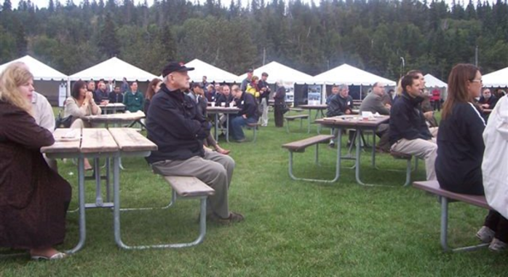

Monday June 29th 4:30-7:30PM
Moon rise - on time - 7:31PM
Just off Fox Drive - Edmonton
Register Online - www.ABCtech.ca

Slide 3

Saying "Thank you!“
TO
Regional contacts and special
interests in the business of technology

Slide 4

Never “too busy”
Canadian Federation of Independent Business
City of Spruce Grove
City of St. Albert
Community Futures – Tawatinaw
Computer Information Processing Society
Daawat East Indian Cuisine
EB Process Engineering
Ecodome Canada
Edmonton Nature Club
Edmonton Research Park
Ekota Central
Frank On-line Marketing
From The Earth Naturally
Gaetz Realty Inc.
Genomics Alberta
German-Cdn Centre for Innovation & Research
AB/Cdn Fusion Energy Program
AIESC - University of Alberta
Alberta Congress Board
Alberta Council of Technologies
Alberta Health Services
Ally Referral Networks
Alopex Management Consulting
Athabasca University
Baer Essential Services
Better Leaders
Biotech Consultant
Blackbridge
BMO Nesbitt Burns
Bodhi Solutions
Brazeau County
Britech Resource
Government of Alberta
Habit
Hogs Head Brewing
Ideaca
ITS Corp
Live & Love Fabulous
MagBoard LLC
MentorUP
Mitacs
NABI
Northlands
Ogilvie Law
Optrics Engineering
OPTY Business Solutions
Parkland County
Peter Trommelen Consulting
Principle Energy Solutions
Spiekers Point
Strathcona County
Suissa Design
Sumex Capital
Tapestry Systems Inc.
TDG Capital
TEC Edmonton
Town of Devon
Turbo gen Power
University of Alberta
U of Alberta - ABCampus
U of Alberta - Electrical Engineering
Visionstate & CSM Systems
Vortex Power & Energy
Whitemud Equine Learning Centre
Willowglen Systems
- Moonlight 2014

Slide 5

SHARING the VISION
“No More Crude Shocks”
Diversifying Alberta's economy …
CREATING WEALTH and RESILIENCE
by commercializing emerging technologies

Slide 6
Creating
ALBERTA'S POST-CARBON FUTURE
&
Converging
SMALL BUSINESS – INNOVATION & COLLABORATION
If you don’t know …

Slide 7

ABOUT ABCtech - Our constituency
Diverse technology and business interests and Hungry!
13,612 contacts SHARING:
A Future Focus: DRIVING Awareness
New Technologies: CHANGING the World
Networking: Driving Change

Slide 8

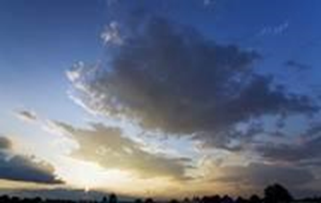
just breathe
Refreshing!

Slide 9
Moonlight in the Meadows
Features follow

Slide 10

#1. FOCUS – A WARM UP
Ted Morton's provocative presentation –
“Mobilizing Alberta's
Wealth For Economic Diversification“
… and a "how to" response

Slide 11


#2. PROMPTING CREATIVE discussion
CleanTech:
Fusion Energy & Climate Change
Electrifying and Automating Transportation
BioTech:
Genomics and Cell Therapies
Agriculture & Food Processing
InfoTech:
Off Loading Intelligence - Machine Learning
Robotics and Smart Drones
Analytics, Big Data & The Cloud
SMEs:
Access to Capital
Understanding SME Success & Failure
Regional Collaboration - Innovation Zones
Change Management:
Innovation & Enterprise
The People - The Passion
Creativity & Convergence
NEVER BORING,
ALWAYS EXPLORING

Slide 12

#3. NETWORKING for small tech businesses and their services
"Meet someone you want to meet again“
Researchers and Entrepreneurs
Academic and Business
Youthful and Wise

Slide 13

#4. APPEALING TO YOUR APPETITES BISTROS & BEVERAGES
Fill 'er up - lotsa samples
Keep talkin - no line ups!

Slide 14
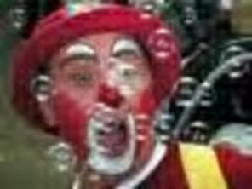

#5. Lite ENTERTAINMENT
Inconspicuous musicians
"Mike" the robotic sound system
Plus a roving reporter

Slide 15
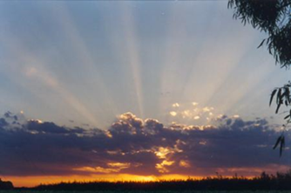
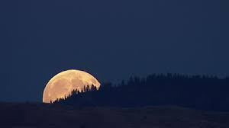
#6. ACCESSIBLE & MEMORABLE
Just off Fox Drive - Free Parking
In the lush meadows of the Region's River
Valley - the showgrounds of WELCA
A golden sunset with the full Moon arising!

Slide 16
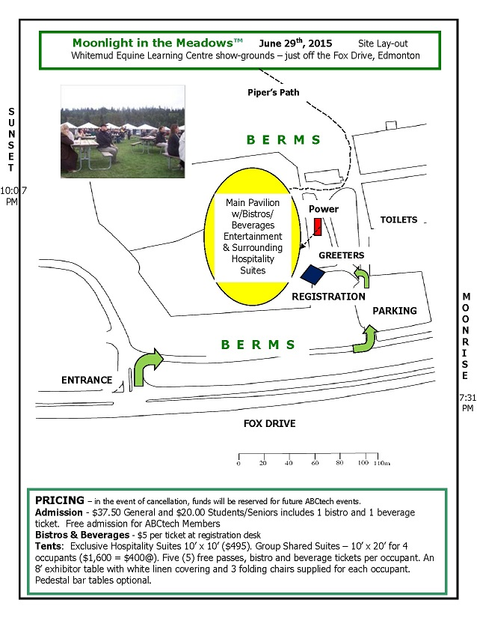
Convenient Site Layout
Registration Desk w/
Volunteers
Field House – Washrooms
Roving Entertainers & Reporter
Main Pavilion w/ surrounding:
Hospitality Suites
Power
Bistro sites
Beverage sites
Free Parking
Lush Meadows under feet
Full Moon rise – 7:37PM
Sun set - 10:07 PM

Slide 17
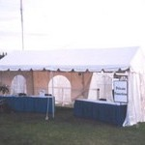
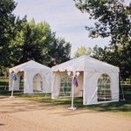
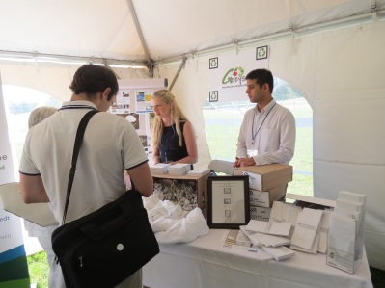
MAKE THIS YOUR BBQ
For your customers and partners - staff too!
We do the work, You have the fun!
AVAILABLE
Hospitality Suite Industry Pavilion
$495 w/ free passes $1,600

Slide 18
Bring A Friend - A Partner - A Date
10-years in the making
Just for the fun of it!
smile

Slide 19

REGISTER NOW - www.ABCtech.ca
$25 Students/Seniors
$37.50 General
Includes a bistro/beverage ticket
Free for ABCtech’s Members
$ 25 Students/Seniors
$100 General

Slide 20

Moonlight in the Meadows
– June 29th
Thank You!
FOR MORE
780-990-5874

