Slide 1
History & Hysteria About ChatGPT
Same old. Same old. Change or be changed!
Prepared for:
PROBUS Club of Central Edmonton
September 19th, 2023
Perry Kinkaide
KEInetwork.net

Slide 2
Setting Expectations
Introduction - Welcome and introduction of the topic. Brief overview of the importance of AI in our lives.
The Emergence of Generative AI - Explanation of generative AI and its significance. Milestones in the development of generative AI, including GPT models. Introduction to ChatGPT as a specific example.
Evolution of ChatGPT - The history and key versions of ChatGPT. Advancements in natural language processing and understanding. Real-world applications of ChatGPT.
Public Concerns: Misinformation - Discussion on the spread of misinformation through AI-generated content. High-profile examples of misinformation incidents involving AI. The impact on public trust and information integrity.
Public Concerns: Privacy - Explanation of privacy concerns related to AI and ChatGPT. Instances of privacy breaches or ethical dilemmas involving AI. The balance between innovation and privacy protection.
Addressing Concerns - Overview of measures taken by developers and organizations to address misinformation. Ethical guidelines and regulations in the AI industry. Ongoing research and development in AI ethics and safety.
The Future of ChatGPT and Generative AI - Potential directions and innovations. Balancing technological advancement with ethical considerations. The role of ChatGPT in shaping the AI landscape.
Conclusion - Recap of key points. Emphasis on the importance of responsible AI development. Encouragement for further discussion and exploration of AI's role in society.
Q&A - Invite questions from the audience.

Slide 3
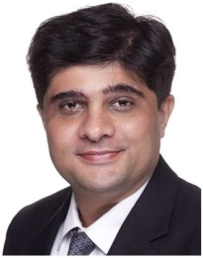
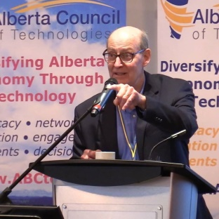
Questions?
Introducing my “posse”
Jwalant Jeff Michelle Brett Bud Ling
Desai Uhlich Lessard Duncan Norris Huang
Perry Kinkaide
KEInetwork.net
PerryKinkaide.com

